Slide 1
Weekly status meeting on MCP Security Score project
05/20/2026

Slide 2
@
Solutions Roadmap – MCP Risk Score
Year 1 |  |  |  | Year 2
Q1 | Q2 | Q3 | Q4 | Q1 | Q2 | Q3 | Q4
Literature Review
Phase II
(Waiting for plan)
Agent Guardian
Testbed Implementation (Lenovo use cases)
Proposed Method Design
Implementation and Ongoing Evaluation (version every 3 months, starting T+6)
We are here: End of Q2
Close Deliverables July, 31
2

Slide 3
Project Scope
Goal: To calculate risk score for requests from AI agents to MCP Servers according to the couple of parameters
Solution: Calculate score according to potential damage on MCP assets

Slide 4
How MCP changes the Threat Model
Traditional SW System
MCP & AI Agents
The system follows a linear flow, e.g. 3-tier-application from user to application to database.
Data and executable instructions are strictly separated.
Inputs are trusted, with the user acting as the primary decision-maker.
Control flow is explicit, based on predefined and auditable logic.
System interactions are bounded, with limited cross-system access.
Execution is deterministic, where identical inputs produce consistent outcomes
The system operates through an agent-mediated flow from user to LLM to MCP tools and downstream assets.
Data and instructions are processed within a unified token space, making them indistinguishable.
Decision-making is delegated to the LLM, which interprets inputs and acts autonomously.
The LLM functions as an active system actor, generating tool calls rather than merely routing requests.
Tool execution is dynamic, with context-driven chaining that evolves during runtime.
System behavior is non-deterministic, where identical inputs may lead to different actions.
The trust boundary is expanded, allowing external content to influence internal system operations.

Slide 5
Illustrative MCP Use Case: Same MCP Server, Different Intent
Benign Scenario
Malicious Scenario
AI
AI Agent (LLM Client)
AI
AI Agent (LLM Client)
User instruction: “Show me customer #42.”
User instruction: “Drop the customers table.”
MCP Protocol · JSON-RPC tool call
MCP Protocol · JSON-RPC tool call
{ "tool":"read_row", "args":{"table":"customers", "id": 42}}
{"tool":"delete_table", "args":{"table":"customers"}}
Local MCP Database Server
Local MCP Database Server
read_row
list_tables
delete_table
read_row
list_tables
delete_table
SQL customers table
SQL customers table
✓
Legitimate read · low risk · allow
!
Destructive call · high risk · deny / gate
Single row returned. Read-only intent matches a low-impact tool.
Same server, same protocol — but a destructive tool with irreversible impact.

Slide 6
Gateway Topology – Defense Architecture
Proposed deployment: a scoring proxy between agents and MCP servers
User 1
Agent 1
Gateway / Proxy
MCP Server 1
Shared downstream service
Intentional misuse
Observe every request
User 2
Agent 2
Assign misuse score
Unintentional misuse
MCP Server 2
Shared downstream service
User 3
Agent 3
Drop / degrade above threshold
Treat agent output as suspicious
...
Normal usage
...
User N
Agent N
MCP Server M
Shared downstream service
Normal usage

Slide 7
MCP Risks Taxonomies – Main highlights from Literature review report

Slide 8
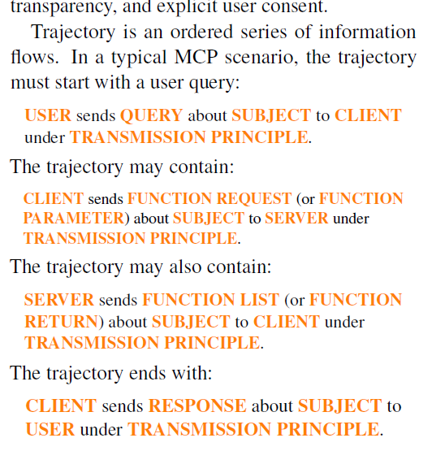

MCIP: Protecting MCP Safety via Model Contextual Integrity Protocol
Huihao Jing, Haoran Li, Wenbin Hu, Qi Hu, Xu Heli, Tianshu Chu, Peizhao Hu, and Yangqiu Song. 2025. Proceedings of the 2025 Conference on Empirical Methods in Natural Language Processing. https://aclanthology.org/2025.emnlp-main.62/
MCIP (Model Contextual Integrity Protocol) is a safety-enhanced version of MCP that addresses MCP's missing security mechanisms while retaining the original functionalities of MCP
MCP interactions occur as natural language dialogues, making it difficult to track, audit, and detect security violations.
Without structured logging, organizations cannot answer critical questions like "Who accessed what data?" or "Which tools were called inappropriately?“
MCIP addresses tracking gaps by adding structured logging.
Tracking Log Formats

Slide 9
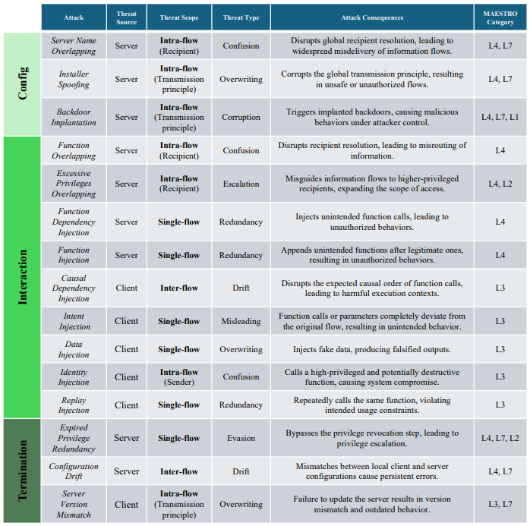
MCIP: Protecting MCP Safety via Model Contextual Integrity Protocol
Huihao Jing, Haoran Li, Wenbin Hu, Qi Hu, Xu Heli, Tianshu Chu, Peizhao Hu, and Yangqiu Song. 2025. Proceedings of the 2025 Conference on Empirical Methods in Natural Language Processing. https://aclanthology.org/2025.emnlp-main.62/
Taxonomy of safety risks for MCP.
The leftmost column of the table shows the phase in which each risk occurs.
The main body maps risks by their source, scope, type, and corresponding MAESTRO layers
Lists 15 unsafe behaviors across three phases (Config, Interaction, Termination), each marked as coming from the server or the client and linked to MAESTRO framework
Pure attack analysis only with mapping to Maestro framework

Slide 10
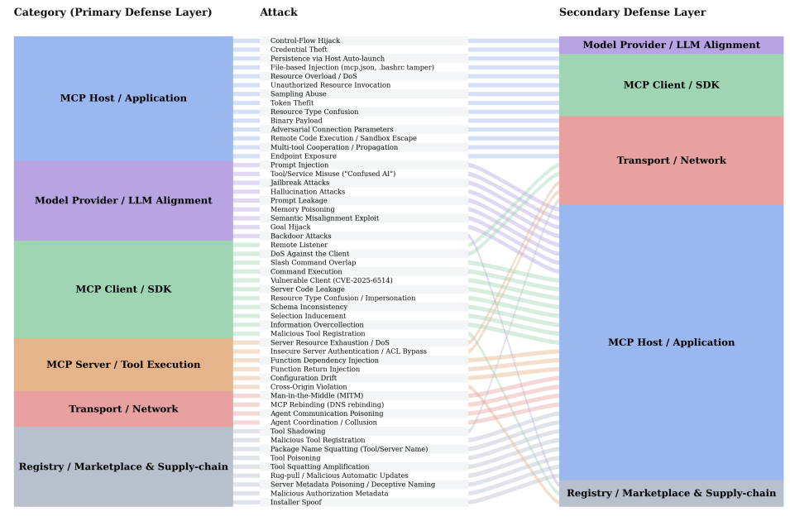
MCP-DPT: A Defense-Placement Taxonomy and Coverage Analysis for Model Context Protocol Security
Rostamzadeh, M., Narula, S., Birhan, N., Ghasemigol, M. and Takabi, D., 2026. arXiv preprint arXiv:2604.07551. https://arxiv.org/abs/2604.07551
MCP-DPT organizes MCP attacks according to the part of the system should defend against.
Defines 6 layers and maps 49 attacks against 13 defenses to show who is responsible for each one.
The layer view makes it easy to see which parts of the system have weak coverage
Limitation: The attack impact isn’t clear – two attacks at the same layer may impact differently
Classify attacks from defense perspective. Affected MCP assets are out of the scope. No scoring

Slide 11
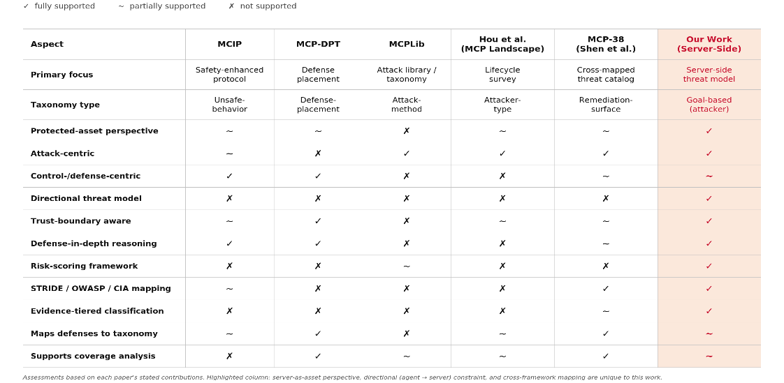
MCP security taxonomies – Summary

Slide 12
Selected Misuse Matrix
SERVER COMPROMISE
DATA EXFILTRATION
ACCESS CONTROL ABUSE
EXHAUSTION
MISUSE
AGENT-MEDIATED
Reverse Shell
Env Var Exposure /
Token Extraction
Privilege Escalation
via Tool Chaining
Resource Exhaustion
RADE
Alignment Failure /
Goal Misalignment
SSH Key Injection
Database Credential
Exposure
Session Abuse /
Temporal Accumulation
Recursive & Circular
Task Exhaustion
Tool Misuse /
Confused Deputy
Log Tampering /
Evidence Destruction
SSRF
OAuth Delegation
Confused Deputy
Denial of Wallet
Toxic Content Gen
via Tool Proxy
Semantic Data
Poisoning
Scraping / Systematic
Data Extraction
Throttle Bypass
Resource Lock
Starvation
Output-Based
Downstream Injection
SQL Injection
SQL Injection
Multi-Tenant Data
Leakage
Browser-Initiated
Tool Execution
(CSRF / DNS Rebind)
Replay Attacks
State Corruption
Timing Side-Channel
Inference
SSE Stream Hijacking /
Session Takeover
Idempotency Abuse
Behavioral
Fingerprinting
Protocol-Level
Exhaustion
25

Slide 13
Research scope – Progress

Slide 14
Different MCPs, same underlying risks
Every MCP server ships its own catalog of tools with its own names — read_file, query_db, send_email, run_shell.
Underneath, they all perform the same handful of operations: read, write, modify, delete, execute, configure.
There is no consistent way to tell a user which tool calls in which contexts can cause real damage.
Benign users trigger critical operations by accident, and reviewers can't audit at scale.
SAME OPERATION, DIFFERENT NAMES
GOAL
Filesystem MCP
Derive a generalizable, automatable pattern that ranks any MCP tool call by its potential for accidental high-impact misuse.
→
Write / Create
write_file
Database MCP
→
Execute
execute_sql
Email MCP
→
Write / Send
send_message

Slide 15
MCP Tool Operation Classes & Potential Risks
Read
Low–Medium
Write / Create
Medium
Update / Modify
Medium–High
Operations:
Operations:
Operations:
query · get · list · search · view
insert · create · send · upload
update · patch · modify · set
Lowest blast radius. Still exposes PII at scale.
Can introduce bad data, spam, record flooding.
Harder to detect — looks like normal operation.
Delete
High–Critical
Execute
Critical
Admin / Config
Critical
Operations:
Operations:
Operations:
delete · remove · purge · flush
run · execute · trigger · call
manage · assign · rotate · migrate
Highest irreversibility. Regulatory exposure.
Lateral movement risk. Highest injection target.
Superuser equivalent. Requires dual approval.
Refs for basis: MCP Tool primitives — modelcontextprotocol.io/specification (Anthropic, Nov 2024) · REST HTTP method semantics — RFC 7231 (IETF, 2014) · Database CRUD conventions · OWASP API Security Top 10 (2023) — owasp.org/API-Security

Slide 16
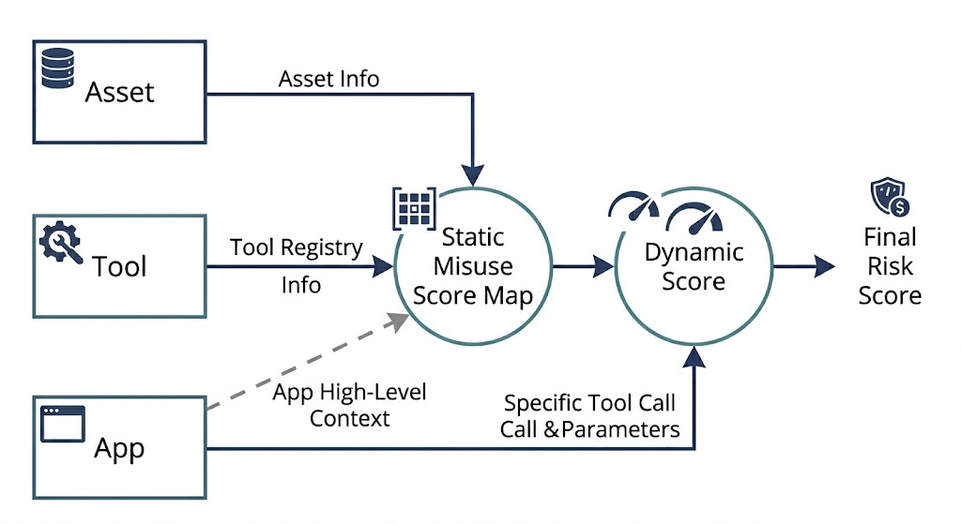
Who we want to do it?

Slide 17
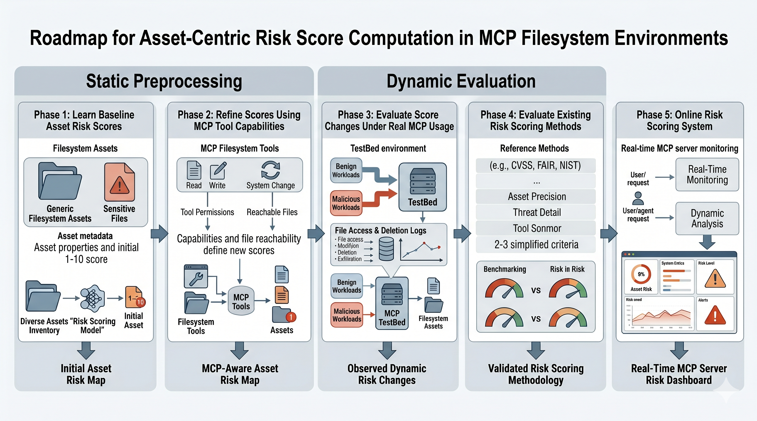
Research Roadmap

Slide 18
POC protocol
We implemented 3 MCP servers as our testbed:
Filesystem MCP
An MCP server that exposes a local directory tree, allowing an AI agent to read, write, and manipulate files on the host machine.
Tools:
read_file
Returns the full content of any file write_file
Creates or overwrites a file with agent-supplied content.
move_file
Relocates a file to a new path.
SQLite MCP
An MCP server wrapping a SQLite database, enabling an AI agent to query and modify structured data through SQL operations.
Tools:
read_query
Executes SELECT statements — grants read access to any table.
write_query
Executes INSERT / UPDATE / DELETE — three blast radii under a single tool name.
list_tables
Returns all table names full schema discovery with one call, the first step in any targeted data attack.
Slack MCP
An MCP server that connects an AI agent to a Slack workspace, enabling it to read messages, post content, and interact with channels.
Tools:
post_message
Sends messages as the authenticated user.
get_channel_history
Retrieves full conversation history.
list_channels
Enumerates all visible channels.

Slide 19
CBG organization simulation for Filesystem MCP
📁 corp_filesystem/
├── 📁 sensitive/
│ ├── 📁 contracts/
│ │ ├── 📄 master_agreement.pdf
│ │ └── 📝 nda_template.docx
│ ├── 📁 financials/
│ │ ├── 📊 budget_2026.xlsx
│ │ └── 📊 payslips_q1.csv
│ └── 📁 security/
│ ├── 🔑 private_key.pem
│ └── 📋 audit_log.txt
├── 📁 source_code/
│ ├── 💻 core.c
│ └── 🔧 build.exe
├── 📁 projects/
│ ├── 📊 known_defects.csv
│ └── 💾 db_schema.sql
├── 📁 onboarding/
│ ├── 📷 org_chart.png
│ └── 📄 policies.pdf
├── 📁 public/
│ ├── 📷 logo.png
│ └── 📄 whitepaper.pdf
└── 📘 README.md
SENSITIVITY
High
sensitive
Mid
projects
Low
onboarding, public
Three exposure tiers in one tree

Slide 20
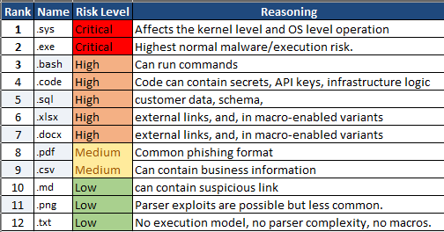
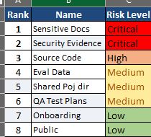
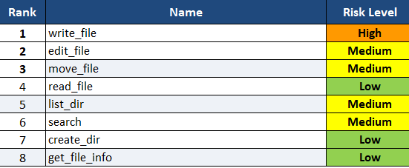
Ranking Tools, Files and Asset
Where (Directory)
What (File Type)
Table1: File categories ranked by CIA-impact severity
How (Tool Operation)
Table 3: File-type assets ranked by combined vulnerability density and potential MCP impact
Table 2: Filesystem MCP tools ranked by the impact of their atomic operation

Slide 21
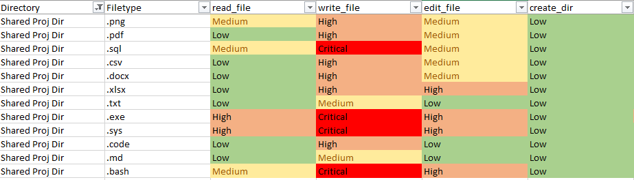
Misuse assessment with respect to tools

Slide 22
Vision: From manual matrix to automated risk classifier for any MCP
Once a new MCP server is registered, we don't need to hand-rank its tools. Each tool can be classified automatically using its signature alone.
1
2
3
4
Classify the tool
▸
Score the target
▸
Combine the dimensions
▸
Decide & log
Map tool name/schema to one of the 6 operation classes (read, write, modify, delete, execute, admin).
Inspect the tool’s arguments. Identify directory and file type.
Apply the combination matrix: max(class_risk, dir_risk, type_risk) with bumps for known dangerous pairs.
Critical → block + require confirmation. High → warn. Medium → log. Low → allow silently.
WORKED EXAMPLE
User calls write_file(path="/shared/proj/migrations.sql", content=…)
Classified as Write/Create → directory Shared Proj (Med) → file type .sql (High) → combined: CRITICAL · require explicit user confirmation.

